Slide 1

Cargo Tracking System
A Path Toward Future

Slide 2

Complete Transparency Solution
Transforming Logistics with Real-Time Visibility
Real-Time Tracking
Pinpoint accuracy at every stage.
Complete Transparency
Unprecedented insight into your supply chain.
Crisis Resilience
Maintain countinity, no matter the challenge
Notes:
1

Slide 3




Current Challenges in Cargo Logistics
Visibility Problems
Business Impact
No real-time updates: Shipments disappear into "black holes" after dispatch.
Customer dissatisfaction: Frustration from lack of information and delayed deliveries.
Unknown shipment status: Lack of granular detail on package location and condition.
Increased support calls (40% overhead): Operations burdened by constant status inquiries.
Missing delivery details: Inability to confirm exact delivery times or recipients.
Uncertain timelines: Difficulty in predicting arrival, leading to missed deadlines.
Competitive disadvantage: Competitors offering better visibility gain market share.
Revenue loss: Penalties for delays, lost business due to poor service.
Customer Ships
BLACKOUT
Package dispatched with high hopes.
No information, no updates, just silence.
Growth
Frustrated Customers
Uncertainty and anxiety grow.
Loss of trust and potential churn.
Notes:
2

Slide 4



Our Comprehensive Solution: End-to-End Visibility
Cutting-Edge Technology
Customer Solutions
Internal Operations
Empowering clients with control and information.
Streamlining workflows and decision-making.
Building on a robust and scalable foundation.
Real-time tracking portal: Intuitive interface for live shipment monitoring.
Unified dashboard: Centralized view of all operations and shipments.
IoT sensors: Real-time data collection from various points.
Automated notifications: Proactive alerts via SMS, email, or app.
AI-driven optimization: Intelligent route planning and resource allocation.
Cloud-native architecture: Scalability, reliability, and global reach.
GPS tracking: Precise location data for every package.
Advanced analytics: Insights into performance, delays, and trends.
API integration: Seamless connectivity with partner systems.
Detailed delivery information: Proof of delivery, recipient names, and timestamps.
Proactive alerts: System-generated warnings for potential issues.
Machine learning predictions: Anticipating delays and optimizing routes.
Notes:
3

Slide 5
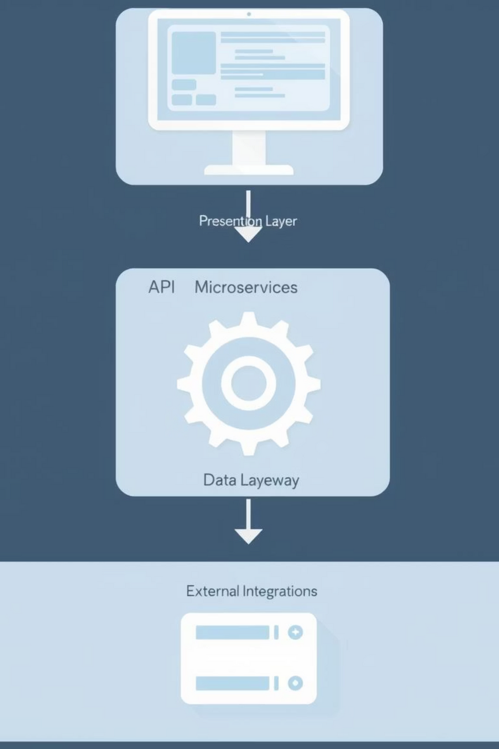

Technical Architecture: A Layered Approach
Our system is built on a robust, scalable, and modular architecture designed for maximum performance and flexibility. Each layer serves a distinct purpose, ensuring seamless data flow and high availability.
Notes:
4

Slide 6
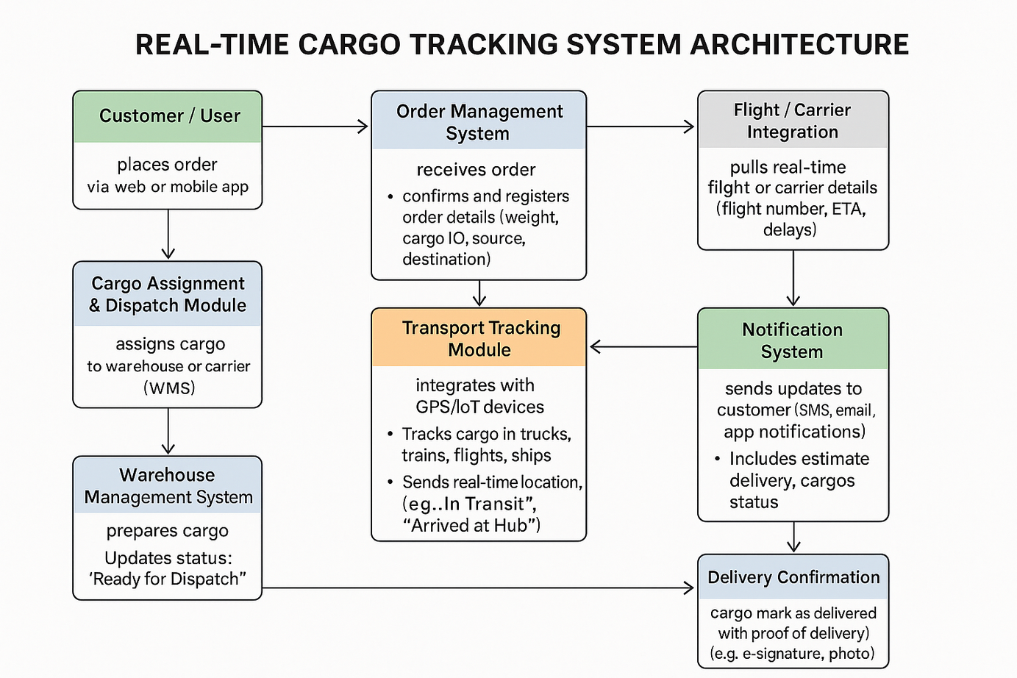
System Components & Data Flow
Core Services
Tracking Service: Processes and stores real-time location data.
Notification Service: Manages and dispatches alerts to stakeholders.
Analytics Service: Aggregates and analyzes historical and real-time data.
Integration Service: Handles communication with external systems and IoT devices.
Databases
PostgreSQL: Relational data, user management, order details.
MongoDB: Flexible document storage for diverse shipment data.
InfluxDB: Time-series data for IoT sensor readings.
Redis: High-speed caching and real-time data streams.
Notes:
5

Slide 7
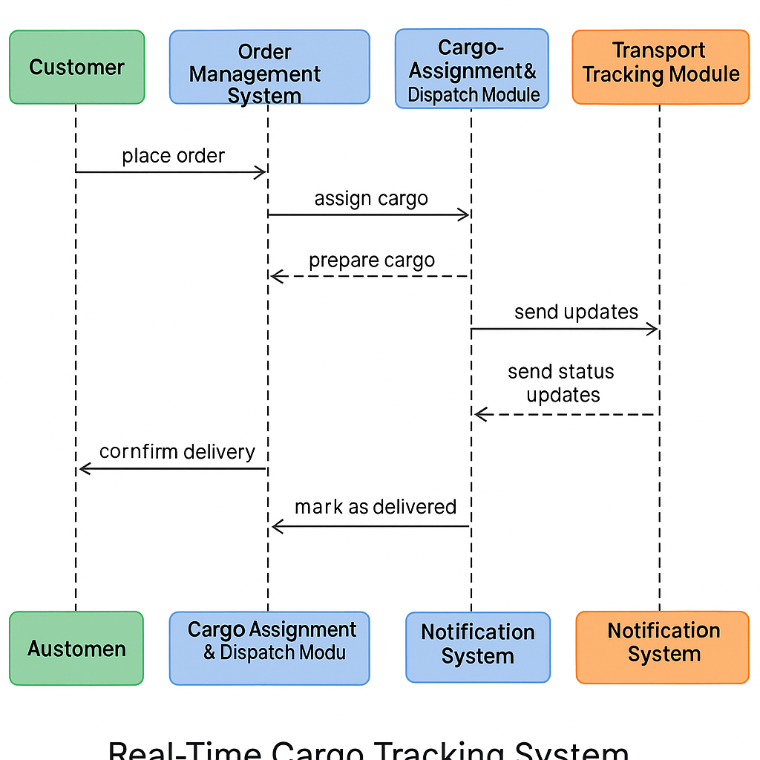
End-to-End Shipment Journey
Our system provides comprehensive visibility and notification at every critical juncture of the shipment process, from initial pickup to final delivery. This ensures all stakeholders are continuously informed.
Notes:
6

Slide 8
Modern Technology Stack for Scalability & Performance
Frontend
1
React.js: Dynamic and responsive web interfaces.
TypeScript: Enhanced code quality and maintainability.
React Native: Cross-platform mobile applications.
Backend
2
Node.js: High-performance, scalable network applications.
Python: Data processing, machine learning, and automation.
Microservices: Modular, independent, and scalable services.
Database
PostgreSQL: Reliable relational data management.
3
MongoDB: Flexible NoSQL for diverse data types.
InfluxDB: Optimized for time-series data from IoT.
Redis: In-memory data store for caching and real-time operations.
Cloud & Orchestration
4
AWS, Azure, GCP: Multi-cloud strategy for resilience and flexibility.
Kubernetes: Container orchestration for automated deployment and scaling.
IoT
5
AWS IoT Core: Securely connect and manage IoT devices.
GPS APIs: Integrate with global positioning systems.
Sensors: Utilize various environmental and motion sensors.
Analytics & ML
6
Elasticsearch: Powerful search and analytics engine.
TensorFlow: Machine learning for predictive analytics.
Prometheus: System monitoring and alerting.
Notes:
7

Slide 9




12-Month Implementation Plan: Roadmap to Transparency
Our phased approach ensures a systematic and efficient rollout, delivering tangible value at each stage and gradually building towards a fully optimized, intelligent logistics system.
Phase 1: Foundation (Months 1-3)
Phase 2: Enhancement (Months 4-6)
Core tracking development
Mobile applications (iOS/Android)
Basic customer portal launch
Advanced analytics dashboard
Initial IoT device integration
Predictive ETA models (basic)
Data ingestion pipeline setup
Automated notification engine
Phase 3: Optimization (Months 7-9)
Phase 4: Innovation (Months 10-12)
AI-driven insights and reporting
Advanced machine learning for anomaly detection
Dynamic route optimization module
Integration of next-gen sensors (e.g., temperature, humidity)
Customizable operational dashboards
Global expansion support and localization
Integration with internal ERP/TMS
API gateway for partner access
Notes:
8

Slide 10

🚨 BREAKING: Crisis Response Required! 🚨
How do we maintain service continuity amidst unforeseen disruptions?
Unpredictability is the new normal. Ensuring uninterrupted logistics operations demands a proactive and resilient strategy.
Aviation Disruptions
Infrastructure Failures
Flight path suspensions due to conflicts or natural disasters.
Major cloud provider outages affecting service availability.
Geopolitical tensions impacting air cargo routes.
System-wide disruptions from cyber-attacks or technical glitches.
Unexpected route closures forcing diversions.
Direct customer impact due to inaccessible tracking or delayed communication.
Notes:
9

Slide 11
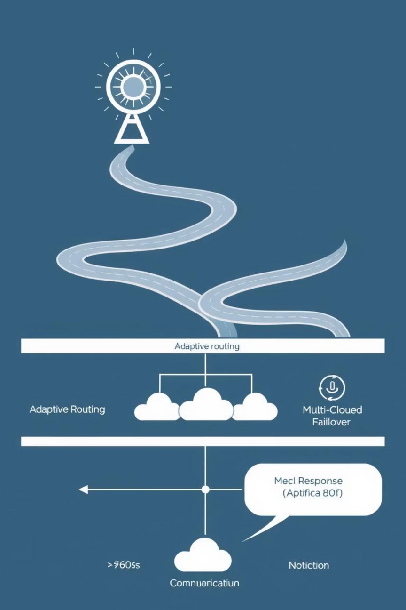
Multi-Dimensional Resilience Strategy
Our architecture is engineered for resilience, anticipating and adapting to disruptions to ensure continuous service and transparent communication, even in crisis situations.
Notes:
10

Slide 12
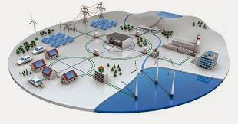
Thank you
For your valuable Time

